Slide 1
Namibia’s Lessons from the Panama Papers

Slide 2
Lessons
The team: Trust, communication
Namibia’s connection to the offshore world?
First leak and learning
Collaborations makes our work better.

Slide 3
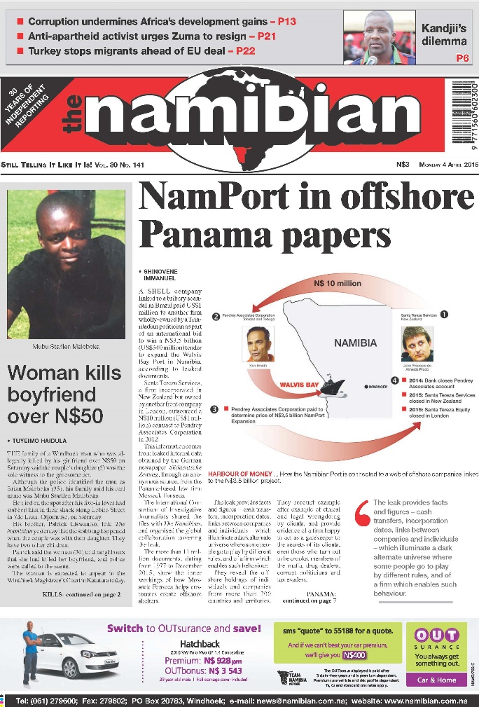
The port deal

Slide 4
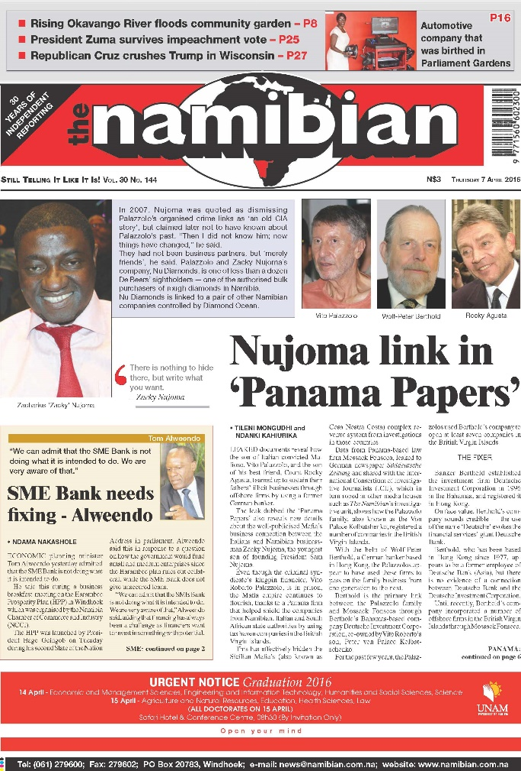
The mafia

Slide 5
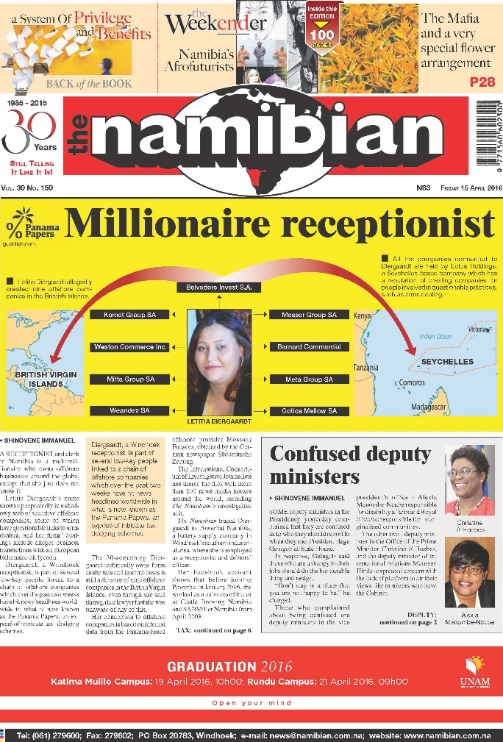
The secretary

Slide 6
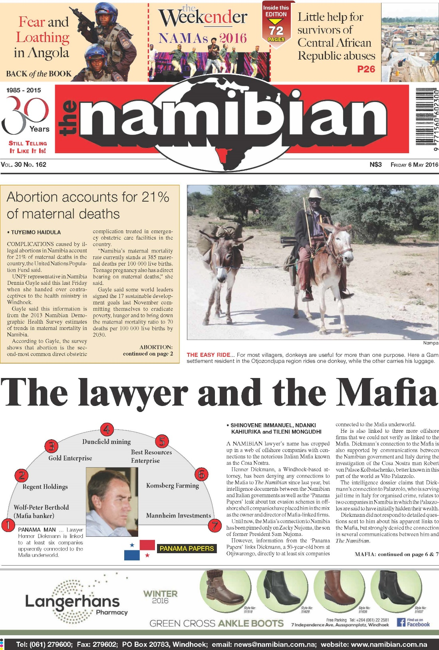
The attorney

Slide 7
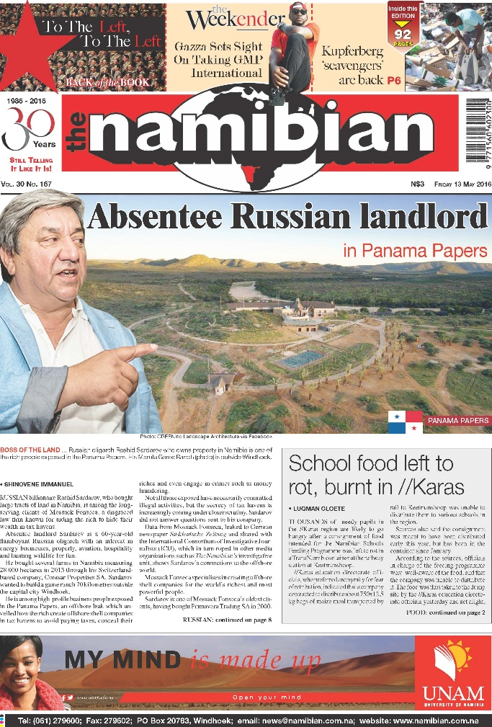
Russian billionaire

Slide 8
Challenges
Do the readers understand?
Impact? So what?
Presentation of our African stories? Length?
Experts?
After the leak? Follow ups?

